Slide 1
Justifying terms of a sequence
Task A: Justifying terms of a sequence
1) Will 467 be in the arithmetic sequence starting -6, 2, 10, 18, …? Justify your answer.
467 will not be in the sequence because it is an odd number.
-6, 2, 10, and 18 are all even numbers and the common difference is even, so the terms will always remain even.
2) 113 and 129 are consecutive terms in an arithmetic sequence. Will 12 718 be in the sequence? Justify your answer.
12 718 will not be in the sequence because it is an even number.
113 and 129 are both odd with an even difference. An odd plus an even will make an odd, therefore the terms will always remain odd.
3) Will 467 be in the arithmetic sequence starting -6, -1, 4, …? Justify your answer.
4 − (−1) = 5
A common difference of 5 sees the sequence continue 4, 9, 14, 19, …
As a translation of the sequence 5n it will always end with a 4 or 9 in the ones column, therefore 467 can not be in the sequence.
4) 113 and 123 are consecutive terms in an arithmetic sequence. Will 12 713 be in the sequence? Justify your answer.
Yes.
123 − 113 = 10
With a common difference of 10 the sequence continues 123, 133, 143, 153, 163, …
This is a translation of the sequence 10n. Every term is “3 more than a multiple of 10” therefore every number 113 or greater that ends with a ones digit of 3 will be in the sequence. This includes 12 713

Slide 2
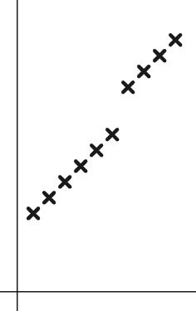

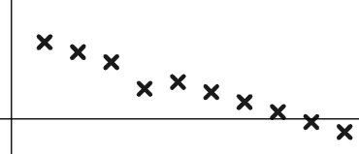
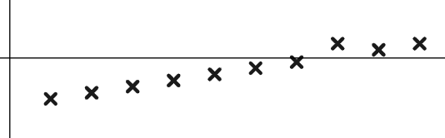
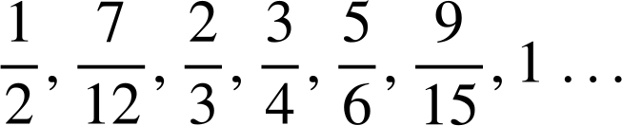
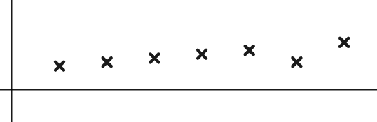

Justifying terns of a sequence
Task B: Using a graphical representation
1) Sam is asked to continue this arithmetic sequence and plot it.
127 850, 135 350, 142 850, …
Term value
They write the below values and plot them.
127 850, 135 350, 142 850, 150 350, 157 850, 165 350, 178 250, 185 750, 193 250, 200 750, …
Term number
Write a sentence explaining how you know there has been an error.
You might have written, “Arithmetic sequences plot in a straight line and on the 7th term the ‘line’ shifts” so there must have been an error here”.
Whilst the graph shows you instantly there has been an error, you might also have noticed in the numbers they ended 850, 350, 850,... then shifted to 250. It was a calculator misread. The 7th term was 172 850.
2) Use the graphs to spot the incorrect terms in these arithmetic sequences.
a) 0.83, 0.72, 0.61, 0.3, 0.39, 0.28, 0.17, 0.06,−0.05,−0.16, …
The 4th term is not in line.
0.3 must not be its value.
Term value
Term number
b) −0.1,−0.85,−0.7,−0.55,−0.4,−0.25,−0.1, 0.35, 0.2, 0.35, …
The 8th term is not in line.
0.35 must not be its value.
Term value
Term number
c)
Term value
The 6th term is not in line.
must not be its value.
Term number

Slide 3
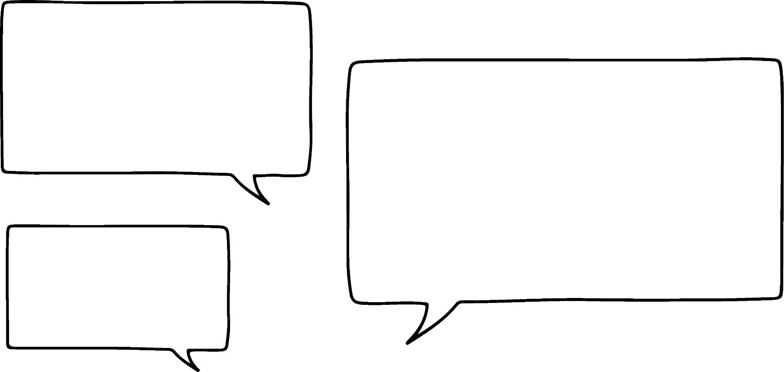

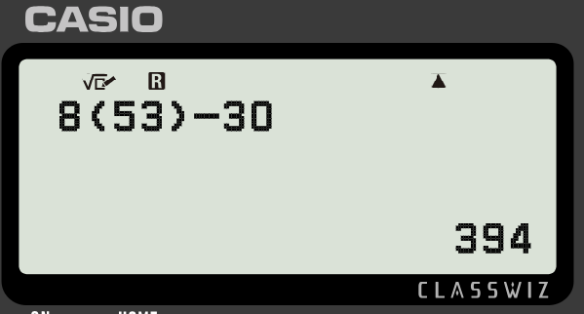
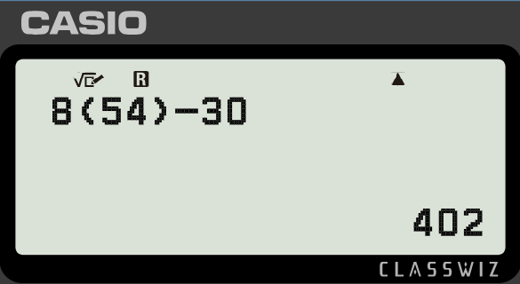
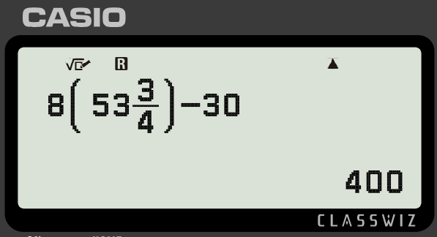
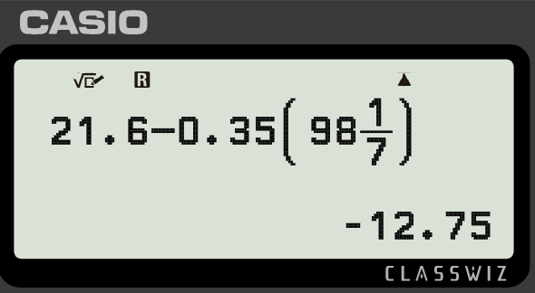
Justifying terms of a sequence
3) Laura is asked if the sequence 117 is in the sequence starting −8, −2, 4, 10, 16, …
She says:
“I’ll draw a graph and see if 117 is in line”
Write a sentence explaining why this might not be the most efficient method to use on this occasion.
You might have included, “The term 117 will have quite a large term number if it is in the sequence, it would take a long time to plot this without technology.
It would be more appropriate, and certainly quicker, to use the odd/even features of this sequence to justify why 117 is not in this sequence”.
Task C: Using the n^{th} term
1) Use n^{th} term and approximation to find 400 in the arithmetic sequence starting 10, 23, 36, 49, …
The n^{th} term is 13n − 3
We can approximate that it is near the 30th term.
n = 30 13(30) − 3 = 390 − 3 = 387
Count on. 387, 400, …
30th
31st
400 is in the sequence. It’s the 31st term.
2) Is 400 in the arithmetic sequence starting −22, −14, −6, 2, …
Write a sentence to justify your answer.
The n^{th} term is 8n − 30 so 400 is approximately the 50th term.
n = 50 8(50) − 30 = 370
Count on: 370, 378, 386, 394, 402, …
394 is the 53rd term, 402 is the 54th term therefore 400 can not be in the sequence.
There is no whole number I can substitute in to 8n − 30 to make 400 and n, the term number, needs to be whole. It is not in the sequence.
3) Is −12.75 in the arithmetic sequence starting 21.25, 20.9, 20.55, 20.2, … Fully justify your answer.
The n^{th} term is 21.6 − 0.35n
21 − 35 = −14 so approximately the 100th term.
n = 100 21.6 − 0.35(100) = −13.4
Count back: −12.7, −13.05, −13.4 …
The non-whole value that makes −12.75 was difficult to find so it’s less appropriate to use this justification on this occasion.
98th
99th
100th
−12.7 is the 98th term, −13.05 is the 99th term therefore −12.75 can not be in the sequence.
Mathematics in Education and Industry
v2.2

